Slide 1
Fostering a DevOps Culture Through the use of an APM Platform
Brien Lay
Sales Engineer, Dynatrace
Brien.Lay@Dynatrace.com
Notes:
The first part of my presentation will focus on why DevOps is important and some theory around DevOps. The second part of my presentation will focus on some of the specific integrations and things you can do with an APM tool like Dynatrace and I will finish by talking about some of the things I did at CSC to make the move to DevOps successful.

Slide 2
My Background
CSC Employee for 15.5 years
Held the following titles while at CSC
Account manager – BPO (1year)
Web Developer – Infrastructure (6 years – ASP, JS, SQL)
Front end developer – POINT IN (3 years - Java, JS)
SR Supervisor – Technical Implementation manager – POINT IN (2 years)
SR System Administrator – Infrastructure (2 years)
Operations, Technical Manager – Infrastructure (1 year)
Came to Dynatrace one year ago before our DevOps transformation was complete.

Slide 3

CSC Environment / History
Build and host Property and Casualty Insurance systems
@85 customers – @1,200 servers (Java on WebSphere, .NET, SQL Server) Win Servers
Created SiteManager – moves all server based code and does SQL moves.
Use SVN for version control.
Regression testing = manual
Load testing – QA Director, load runner
Operations / configuration management staff – 12 employees (mostly non-skilled).
Infrastructure staff – 18
Mostly Waterfall (some teams do Agile, but in reality they are all waterfall).
Prior to 2012 – no focus on performance. Insurance systems have a mostly captive audience.
Started to loose deals to our competition.

Slide 4
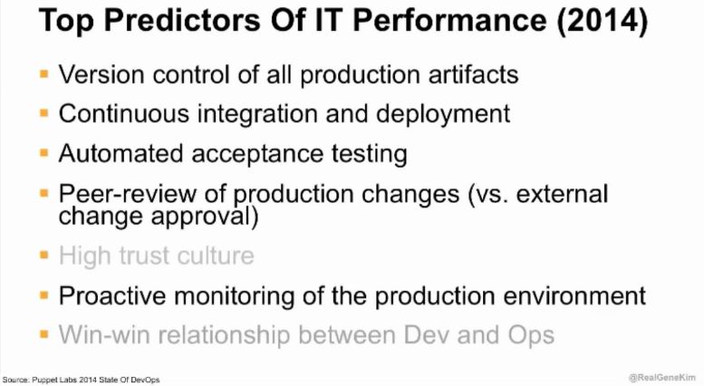

Slide 5
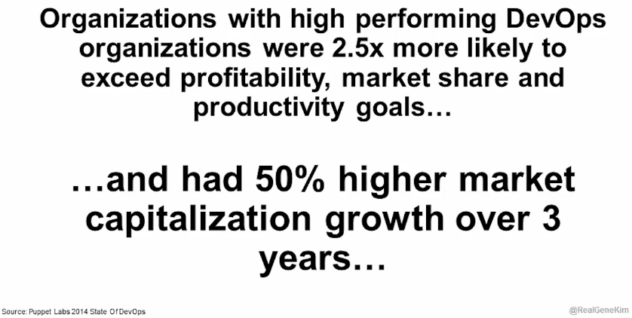
Notes:
DevOps does matter and helps organizations win. If you are looking for support from management to support and foster a DevOps based culture, these statistics should make help support your argument.

Slide 6
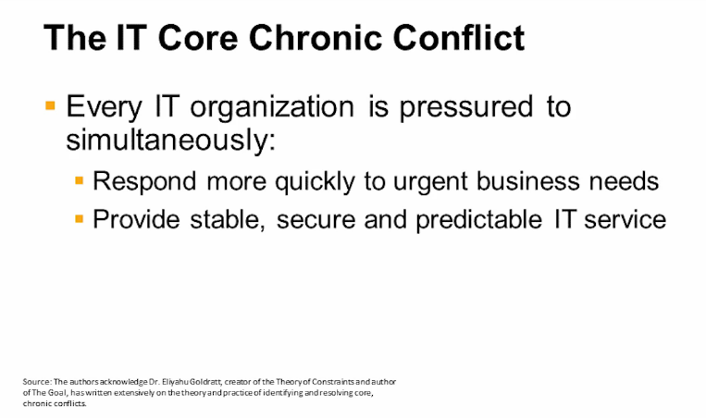

Slide 7
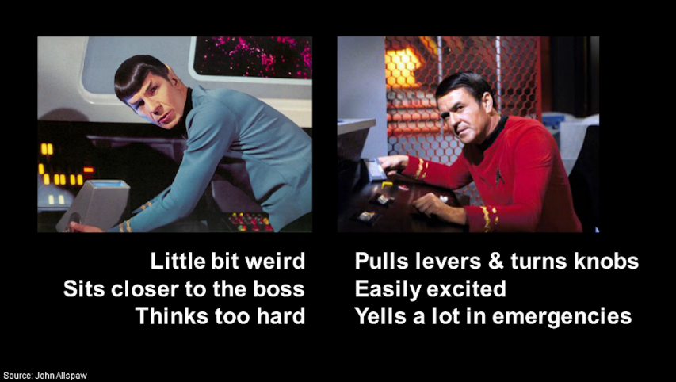
Dev
Ops

Slide 8

Notes:
We need to break down the IT silos to foster communication and collaboration across IT. Communication and collaboration is the key to adoption.

Slide 9
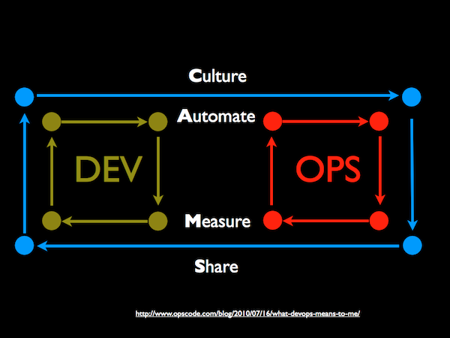
Solution: DevOps + Performance Focus
Notes:
CAMS is taken from OpsCode (Creators of Chef) Blog: http://www.opscode.com/blog/2010/07/16/what-devops-means-to-me/
Culture People and process first. If you don’t have culture, all automation attempts will be fruitless. PERFORMANCE is a key requirement for everything that is done throughout the delivery chain. A lot of the problems that lead to a War Room scenario are problems that could be found earlier if there would be a focus on Performance and Quality throughout the organization. The change that is required is already well understood in the DevOps movement that’s been going on for years – BUT – it is important to add Performance as Key Requirement to Culture, Automation, Measurement and Sharing.
Automation This is one of the places you start once you understand your culture. At this point, the tools can start to stitch together an automation fabric for Devops. Tools for release management, provisioning, configuration management, systems integration, monitoring and control, and orchestration become important pieces in building a Devops fabric. : Automation is Key for DevOps and Agile Development. What needs to change is that performance and architectural problems are automatically detected in the development and delivery process. This can be achieved by focusing automated testing for exactly these problems – whether it is in C/I or in the “traditional” test area
Measurement If you can’t measure, you can’t improve. A successful Devops implementation will measure everything it can as often as it can… performance metrics, process metrics, and even people metrics to be able to do things like quantify the quality and performance of a developers code over the course of the past year to use in performance reviews or simply to use as a learning tool. We can only measure success if we have Key Performance Indicators for each team, e.g: Test Coverage %, Number of Tests Executed, Throughput, Response Time, Number of Deployments, … - an additional focus must be on measures that allow us to track performance and architectural issues, e.g: # SQL Statements, # Errors, # Exceptions, etc... This allows us to identify and prevent any performance regressions as soon as they get introduced
Sharing Sharing is the loopback in the CAMS cycle. Creating a culture where people share ideas and problems is critical. Jody Mulleky the CIO at Shopzilla, said that they get in the war room the developers and operations teams describe the problem as the enemy, not each other. Another interesting motivation in the Devops movement is the way sharing Devops success stories helps others. First, it attracts talent, and second, there is a belief that by exposing ideas you can create a great open feedback that in the end helps them improve

Slide 10
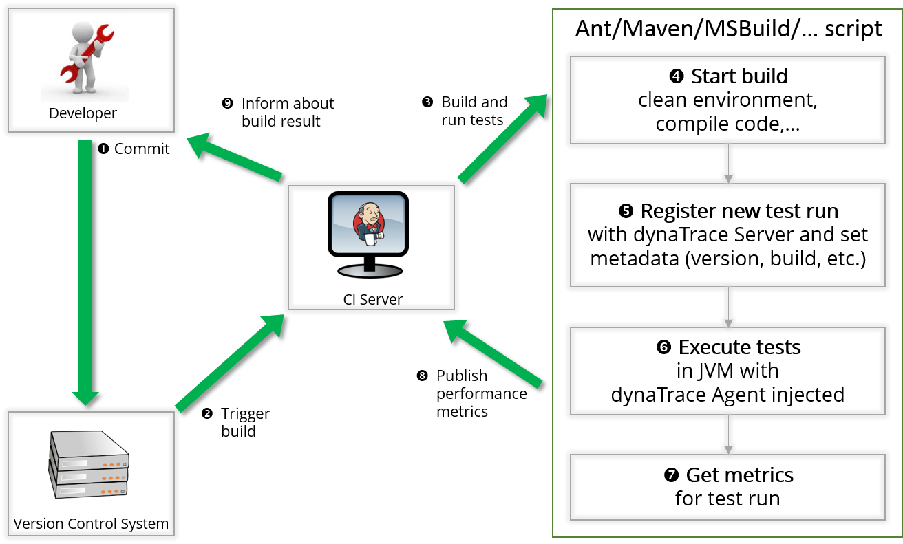
The Ideal End State

Slide 11
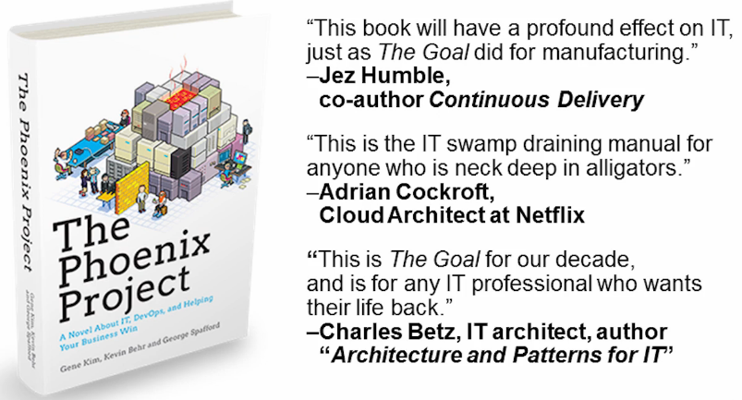

Slide 12
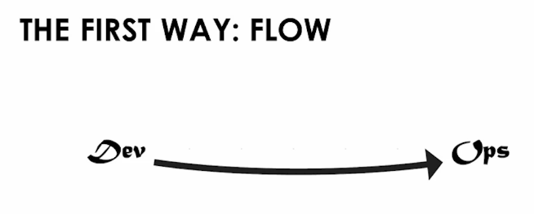
Notes:
Systems Thinking. Performance of the entire system.
The outcomes of putting the First Way into practice include never passing a known defect to downstream work centers, never allowing local optimization to create global degradation, always seeking to increase flow, and always seeking to achieve profound understanding of the system (as per Deming).

Slide 13
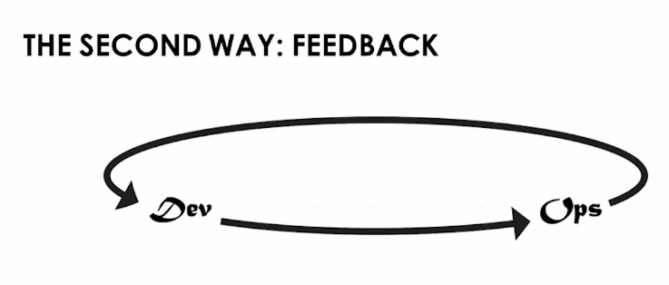
Notes:
Faster detection and recovery. Shorten and amplify feedback loops so necessary corrections can be continually made..

Slide 14
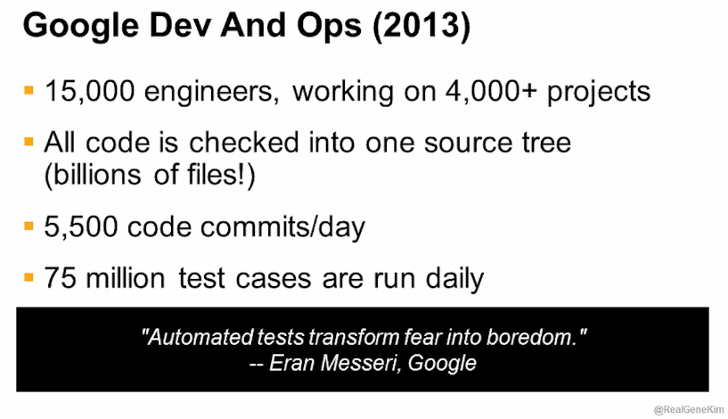
Notes:
Leader in the DevOps space. Why would they write 75m cases let alone run them. “It is only through automated testing that we can transform fear into boredom.” They do this because there is a safety net supporting the developers. They need to not be afraid to fail. Empower the person doing the change to decide what to change, how to change, and when to change it.

Slide 15
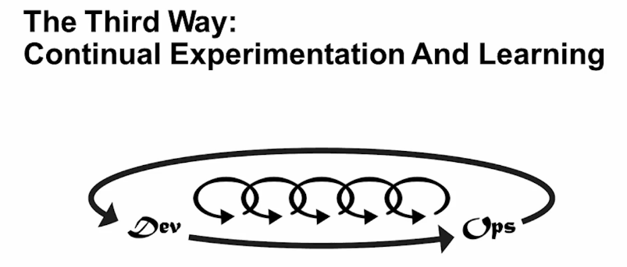
Notes:
The Third Way is about creating a culture that fosters two things: continual experimentation, taking risks and learning from failure; and understanding that repetition and practice is the prerequisite to mastery.
We need both of these equally. Experimentation and taking risks are what ensures that we keep pushing to improve, even if it means going deeper into the danger zone than we’ve ever gone. And we need mastery of the skills that can help us retreat out of the danger zone when we’ve gone too far.
The outcomes of the Third Way include allocating time for the improvement of daily work, creating rituals that reward the team for taking risks, and introducing faults into the system to increase resilience.
Test Automation is the safety blanket.

Slide 16
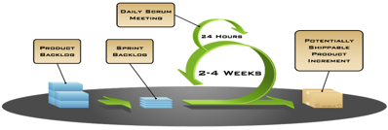
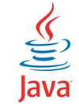





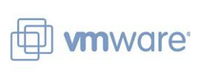





The New Technical Reality
Continuous Delivery creates rapidly changing applications
Built in diverse languages and running on diverse language runtimes
Deployed on multiple virtualization platforms
Running on scaled out commodity hardware
Located in multiple clouds with multiple owners
Your Cloud
Hybrid Cloud
Public Cloud

Slide 17

New Reality, New Questions
How can development, QA and Ops teams have common data they can trust?
How can I catch more performance problems before they hit production?
How can realistic performance tests be automated into my CI chain?
How can I troubleshoot problems faster?
How can I reduce unplanned work?

Slide 18

What’s preventing faster AND higher quality releases?
Developers can not easily recreate production problems, leading to unplanned work
Data captured in Ops can’t be actioned by Dev
Scalability and performance hotspots are not properly detected in test/QA
No way to compare performance from build to build
How can I catch more performance problems before they hit production?
How can development, QA and Ops teams have common data they can trust?
How can realistic performance tests be automated into my CI chain?
How can I troubleshoot problems faster?
How can I reduce unplanned work?

Slide 19
High performing organizations are more agile and more reliable
30x
2x
50x
12x
more frequent deployments
the change success rate
Fewer failures
Faster mean time to recover (MTTR)
Source: Puppet Labs 2014 State Of DevOps https://puppetlabs.com/2014-devops-report
Notes:
High Performers are massively outperforming their competition. This includes both code and environment deploys. How long from code commit to the time it is in production? High performers can do it in minutes or hours. Non High Performers can deploy in terms of weeks or months. This show us we can increase the rate of change while improving quality.

Slide 20

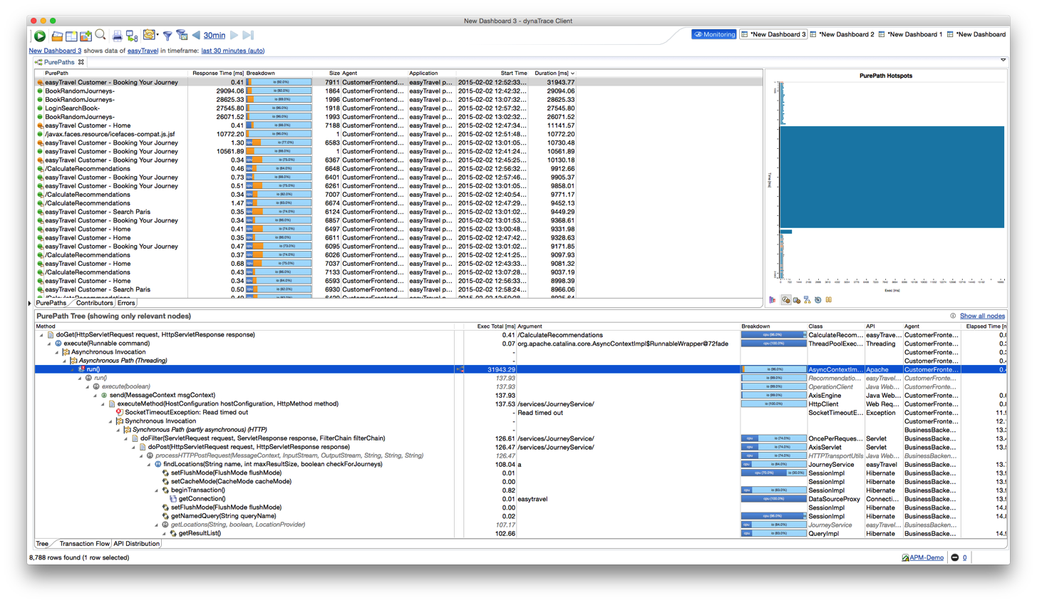
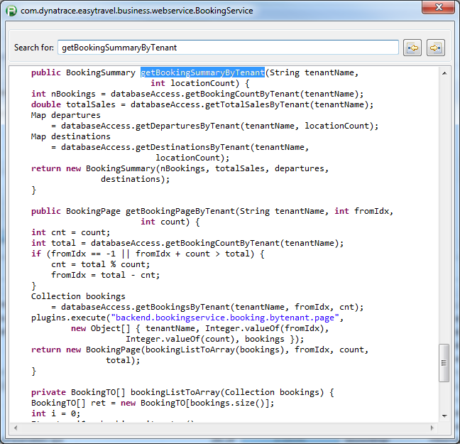
cross-tier method-level analysis
Gap-Free Data
line-of-code facts for problem resolution
method arguments, bind values and more for individual transactions

Slide 21
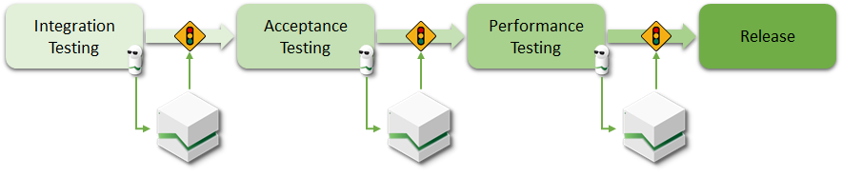
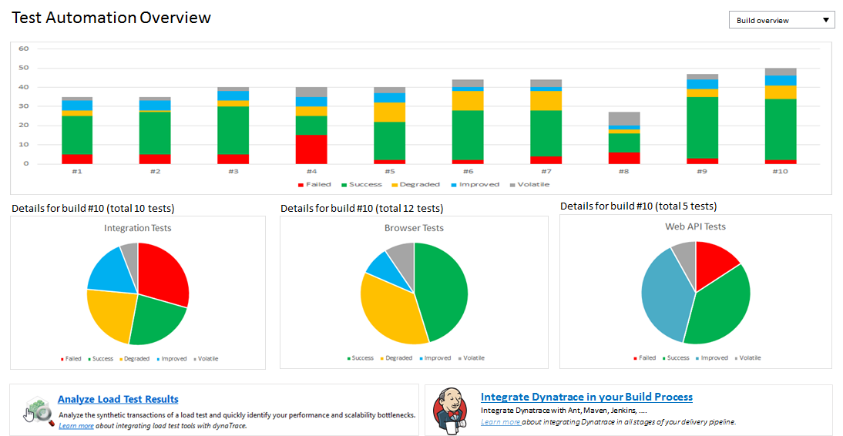

Gap-Free Data
quantify build-over-build progress
Performance Build & Test Automation
summary test results for integration, browser, …

Slide 22
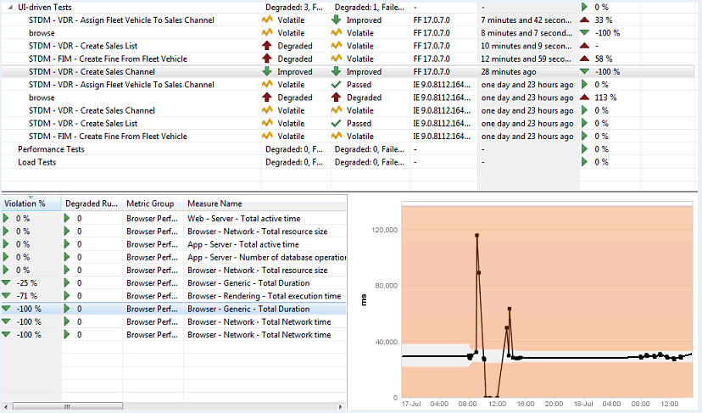
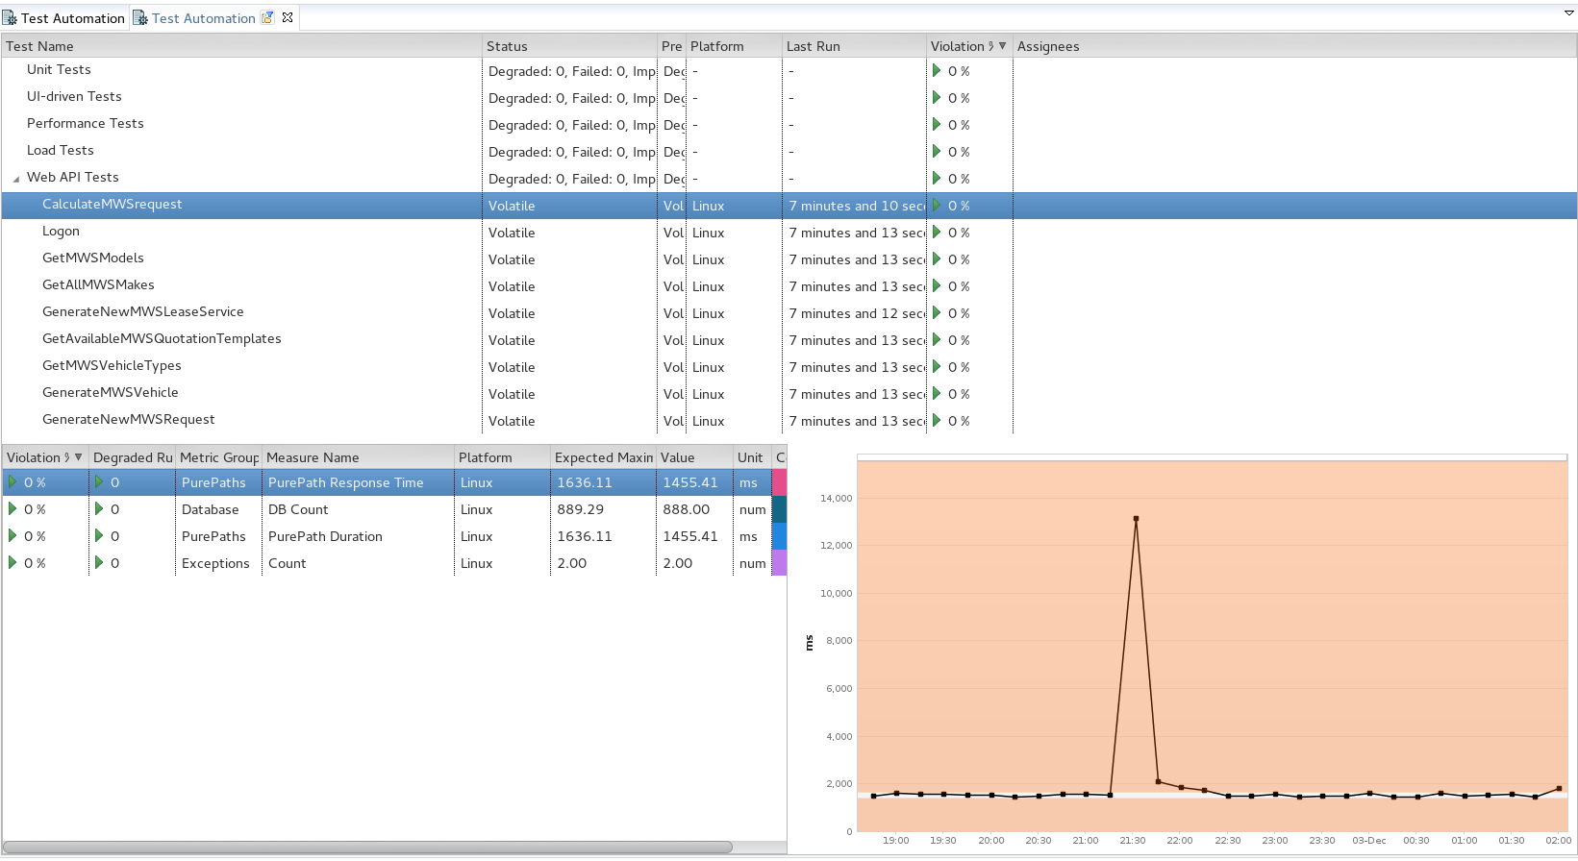

overview of all executed tests with status
Gap-Free Data
Performance Build & Test Automation
Anti-Pattern Analytics
trending with automatic baslines
detailed metrics per test
Notes:
Test Automation Dashboard
Provides an overview of all executed tests
Clear indication of test status and evolution
Set of detailed metrics per test
Trending with automatic baseline functionality
Explain the story around the graph, what happened
Performance regression occurred
Developer fixed it
Test failed dramatically after that (unstable)
Finally managed to fix it in a stable way (functionall & performant)

Slide 23



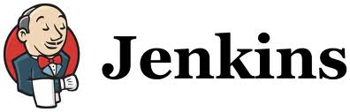

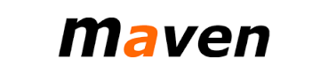







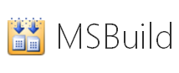

Gap-Free Data
IDE Support
Test Automation
Build Automation
Build Server / CI
Performance Build & Test Automation
Ant
Anti-Pattern Analytics
Silk Performer
IntelliJ IDEA
DevOps Toolchain Integration
Selenium and WebDriver
Notes:
Seamless integration with any build environment makes performance-driven development a continuous, proactive process. Build better apps the first time around.
We're the only solution to provide reliable metrics along your delivery pipeline through automation interfaces for CI/CD systems like Jenkins, Bamboo, and TeamCity.

Slide 24
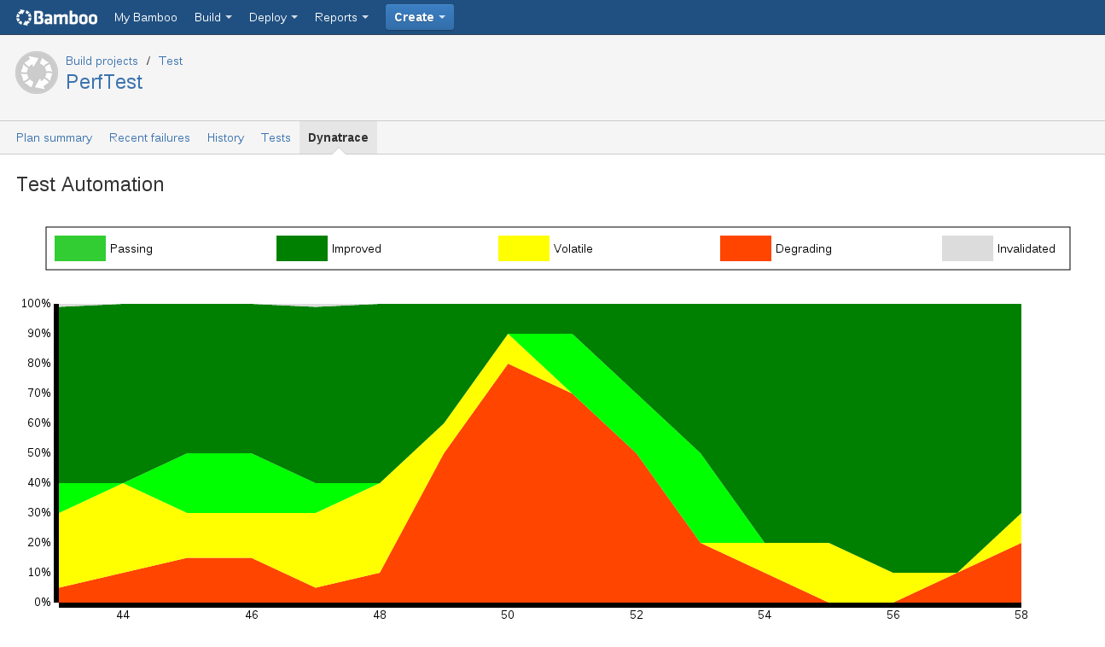
Gap-Free Data
view trends and status within build automation tooling
Performance Build & Test Automation
Anti-Pattern Analytics
DevOps Toolchain Integration
Notes:
Tell the story behind the graph
Developer makes some changes to resolve performance issue
Changes seem to have the reverse effect
Developer continues making changes resulting in the resolution of the performance issue(s)
Why is this important
Automatic notification after each build
Automatic failure of builds based on test autcome as well as performance outcome
Visibility

Slide 25
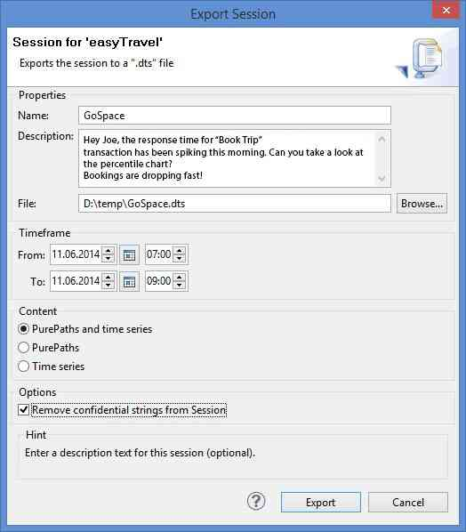
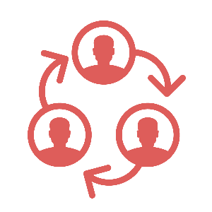
deliver facts to avoid blamestorming
Gap-Free Data
Performance Build & Test Automation
Anti-Pattern Analytics
DevOps Toolchain Integration
Production Problem Capture

Slide 26

Measurement: Define KPIs accepted by all teams
Perf Test Code Coverage
Response Times
# of SQL Executions
MBs / User
Time for Rollback
# of Log Lines
Time for Deployment
Notes:
Some examples on KPIs
Number of SQL Statements executed
-> tells Ops on what to expect in production
-> tells architects on whether to optimize this with a cache or a different DB Access Strategy
Number of Log Lines
-> tells Ops how to optimize storage for Logging
-> tells architects whether there is LOG SPAM happening
Memory Consumption per User Session
-> tells Ops how to scale their production environment
-> tells architects whether you are “wasteful” with heap space
Time for a single Deployment
Time for rollbacks

Slide 27
How? Performance Focus in Test Automation
Lets look behind the scenes
Test Framework Results
Architectural Data
Build # | Test Case | Status
# SQL | # Excep | CPU
Build 17 | testPurchase | OK
 | testSearch | OK
12 | 0 | 120ms
3 | 1 | 68ms
Build 18 | testPurchase | FAILED
 | testSearch | OK
12 | 5 | 60ms
3 | 1 | 68ms
Build 19 | testPurchase | OK
 | testSearch | OK
75 | 0 | 230ms
3 | 1 | 68ms
Build 20 | testPurchase | OK
 | testSearch | OK
12 | 0 | 120ms
3 | 1 | 68ms
We identified a regresesion
Exceptions probably reason for failed tests
Problem fixed but now we have an architectural regression
Problem solved
Problem fixed but now we have an architectural regression
Now we have the functional and architectural confidence
Notes:
When we look at the results of your Testing Framework from Build over Build we can easily spot functional regressions. In our example we see that testPurchase fails in Build 18. We notify the developer, problem gets fixed and with Build 19 we are back to functional correctness.
Looking behind the scenes
The problem is that Functional Testing only verifies the functionality to the caller of the tested function. Using dynaTrace we are able to analyze the internals of the tested code. We analyze metrics such as Number of Executed SQL Statements, Number of Exceptions thrown, Time spent on CPU, Memory Consumption, Number of Remoting Calls, Transfered Bytes, …
In Build 18 we can see a nice correlation of Exceptions to the failed functional test. We can assume that one of these exceptions caused the problem. For a developer it would be very helpful to get exception information which helps to quickly identify the root cause of the problem and solve it faster.
In Build 19 the Testing Framework indicates ALL GREEN. When we look behind the scenes we see that we have a big jump in SQL Statements as well as CPU Usage. What just happened? The Developer fixed the functional problem but introduced an architectural regression. This needs to be looked into – otherwise this change will have negative impact on the application once tested under load
In Build 20 all these problems are fixed. We are still meeting our functional goals and are back to acceptable number of SQL Statements, Exceptions, CPU Usage, …

Slide 28
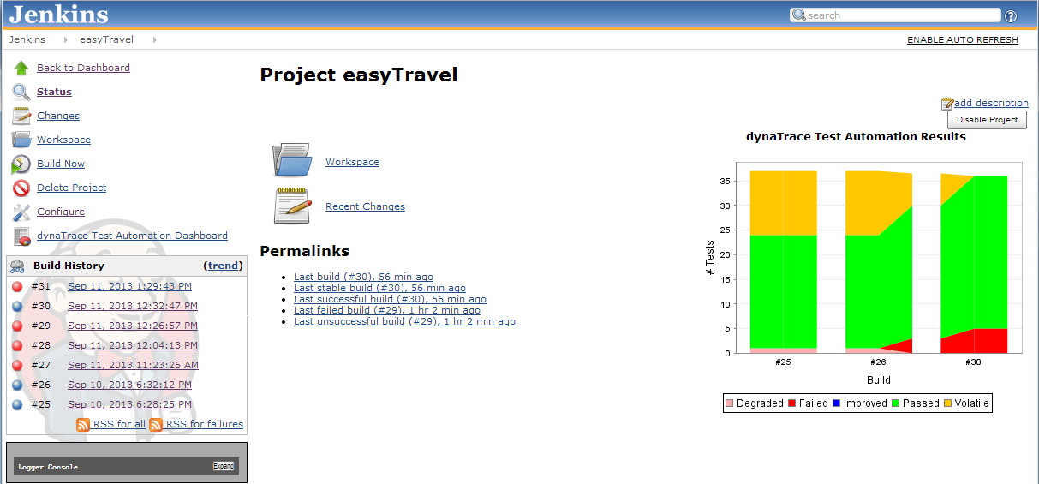
Performance Focus in Test Automation
Embed your Architectural Results in Jenkins

Slide 29
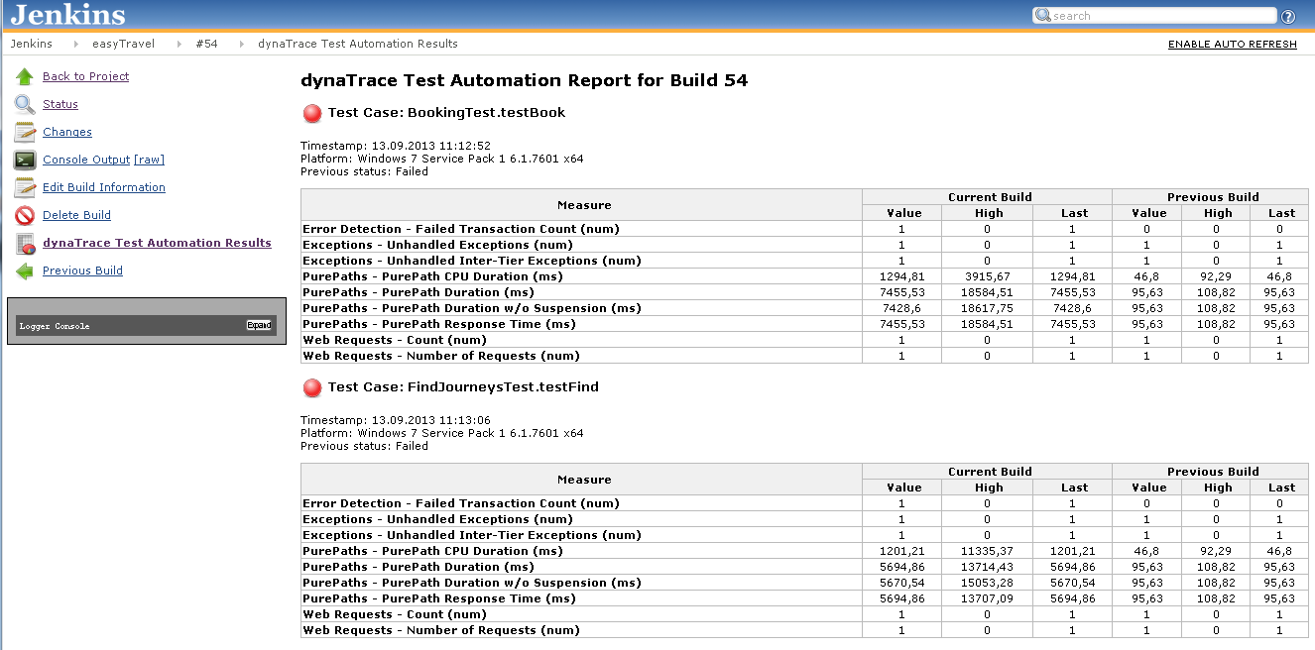
Performance Focus in Test Automation
Build-level Performance Metrics

Slide 30
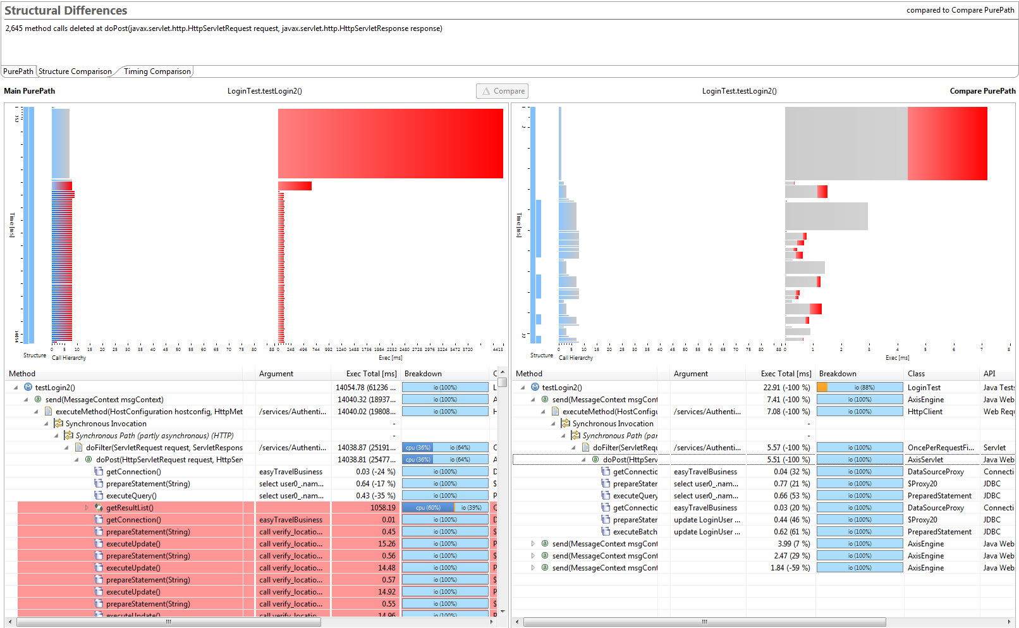
Notes:
PurePath compare screen showing the structural and timing differences for two different transactions of the same type.

Slide 31

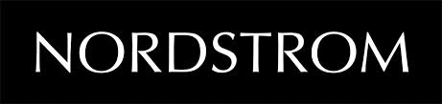
“
nordstrom
Dynatrace was instrumental in reducing our release cycle from 4 times a year to once a month”
-Gopal Brugalette, Performance Architect
Notes:
Video: Coming Soon

Slide 32
Internal CSC Successes using Dynatrace
Incorporation into our software development lifecycle.
Base development teams for our major products now use Dynatrace
Exceed, POINT IN, Agency Link, Riskmaster
Performance Lab – all releases strictly tested using Dynatrace integration.
Deployments went from months down to days.
Customer Relationships
Major impact to improving systems = happy customers
Sharing of session files / co-development with customers
Dynatrace displaced CA at CSC as the APM Vendor of Choice.
Notes:
Once we demonstrated the value in production of an APM tool, the architects and developers that understood the potential impact, were all in and were behind my efforts to get into the lower environments.

Slide 33
Internal Success – Measured at 6 Months – Nov. 2012
THE CHALLENGE
CSC’s P&C solution provides leading insurance companies with the most advanced insurance software on the market via a globally connected network of outsourcing centers.
Larger customers require extensive software customization which introduces defects
Serious defects involved “war rooms” of 6-12 people, and could take 1-2 days to resolve.
Defects are costly, disruptive and time-consuming to resolve, especially for “live” customers.
The Arch Insurance project alone generated 2963 defects which cost >$1.33M to resolve
Defects impact SLAs – bug fix delays result in additional costs
THE BUSINESS BENEFITS
dynaTrace has reduced the cost of fixing defects by about 40%
Prior to using dT, a typical defect would cost about $449 to fix.
Using dT, 80% of defects can be found and resolved at a cost of about $225
Swiss RE : 3,885 defects
Without dT
3,885 defects @ $449 = $1.744M
With dT
80% fixed@ $225 = $699K
20% fixed@ $449 = $349K
Total cost = $1.048M
Savings = $696K (40%) in 5 mos.
Improved the quality of SLA reporting & tracking violations

Slide 34
ROME WAS NOT BUILT IN A DAY
Tie code quality and performance to developers
SPONSORSHIP
DON’T BE AFRAID TO FAIL
Share your successes
TALENT
KNOWLEDGE
Notes:
KEY POINTS
Rome was not built in a day and neither is a successful Performance Practice
Objectively evaluate your developers based on the quality and performance of their code.
Executive sponsorship is crucial in implementing a successful practice
Do not be afraid to fail and get it wrong. What works for one team may not work for another
Publish your successes to as wide an audience as possible.
Talent trumps knowledge. Get people on board that are not familiar with the applications they are tasked to manage. No preconceived ideas. Question everything.

Slide 35
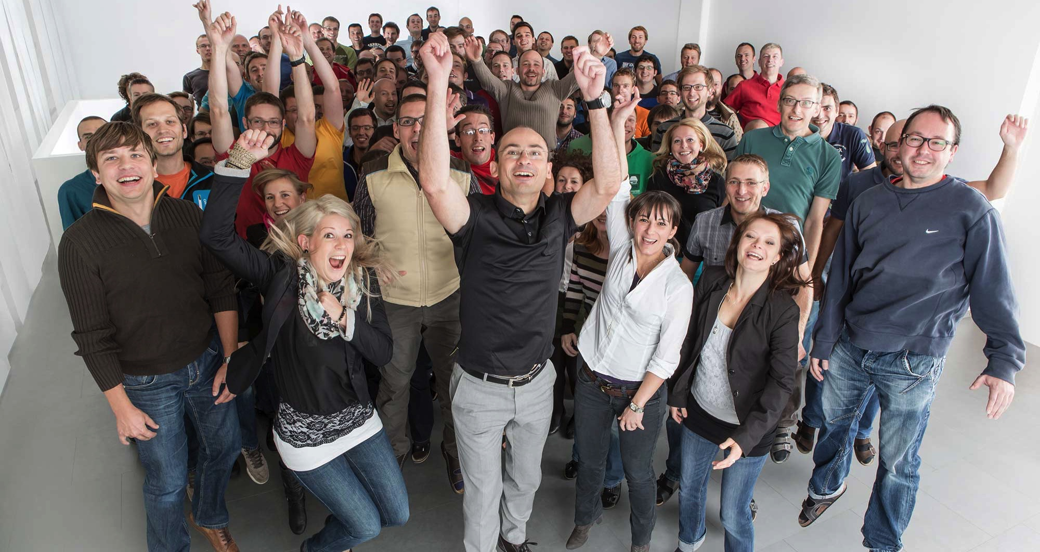
What we believe
It starts and end with the user - Not the app
Gap-free data is essential
The goal is Dev/Ops not Just/Ops

Slide 36
Additional Resources
DevOps / Lifecycle blog - http://apmblog.dynatrace.com/category/lifecycle-devops/
Dynatrace recorded Webinars - http://www.dynatrace.com/en/resources/webinars.html
Load testing tool integration - https://www.youtube.com/watch?v=26nVM_JgStw&list=PLqt2rd0eew1bmDn54E2_M2uvbhm_WxY_6&index=15
Dynatrace helps build a DevOps culture -

Slide 37
www.dynatrace.com

